Slide 1

Support Vector Machine (SVM)
Aksadur Rahman
aksadur@yahoo.com

Slide 2
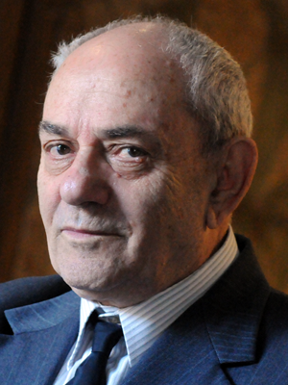
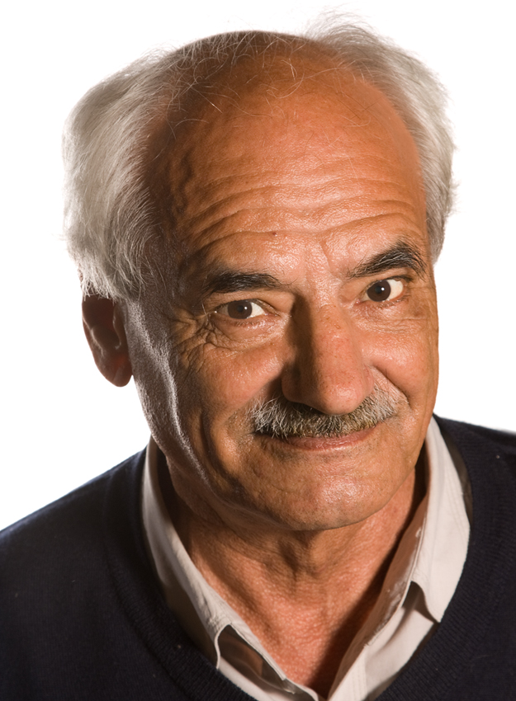
Support Vector Machine (SVM)
When was SVM introduced?
Ans: 1992
Vladimir N. Vapnik
Alexey Chervonenkis

Slide 3
Support Vector Machine (SVM)
Support Vector Machine or SVM is one of the most popular Supervised Learning algorithms, which is used for Classification as well as Regression problems. However, primarily, it is used for Classification problems in Machine Learning.
The goal of the SVM algorithm is to create the best line or decision boundary that can segregate n-dimensional space into classes so that we can easily put the new data point in the correct category in the future. This best decision boundary is called a hyperplane.

Slide 4
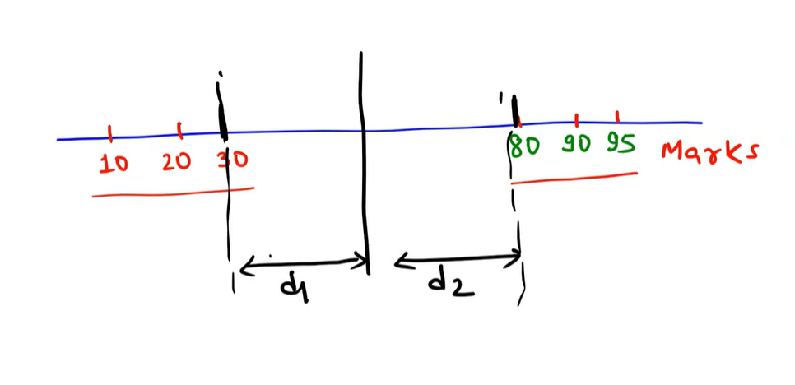
Support Vector Machine (SVM)

Slide 5
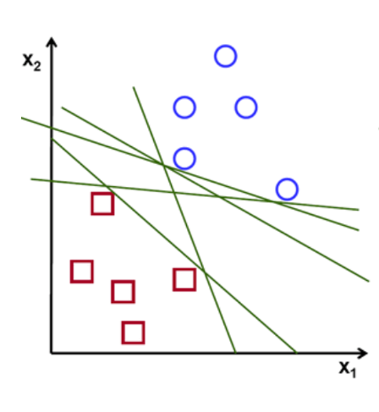
Support Vector Machine (SVM)

Slide 6
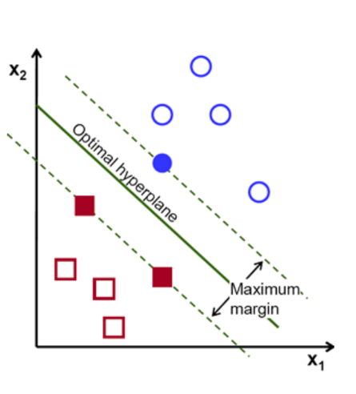
Support Vector Machine (SVM)

Slide 7
Support Vector Machine (SVM)

Slide 8
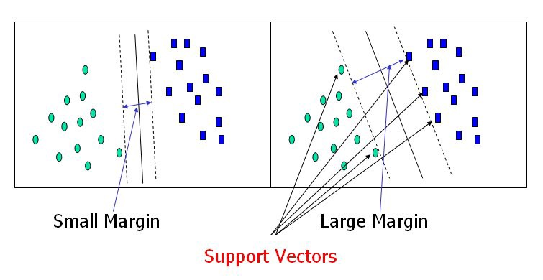
Support Vector Machine (SVM)

Slide 9
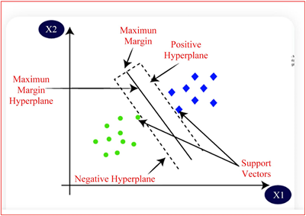
Support Vector Machine (SVM)

Slide 10
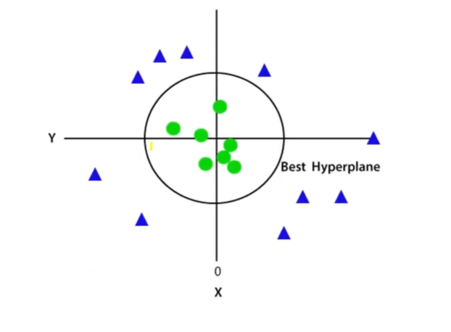
Support Vector Machine (SVM)
Non Linear Hyperplane

Slide 11
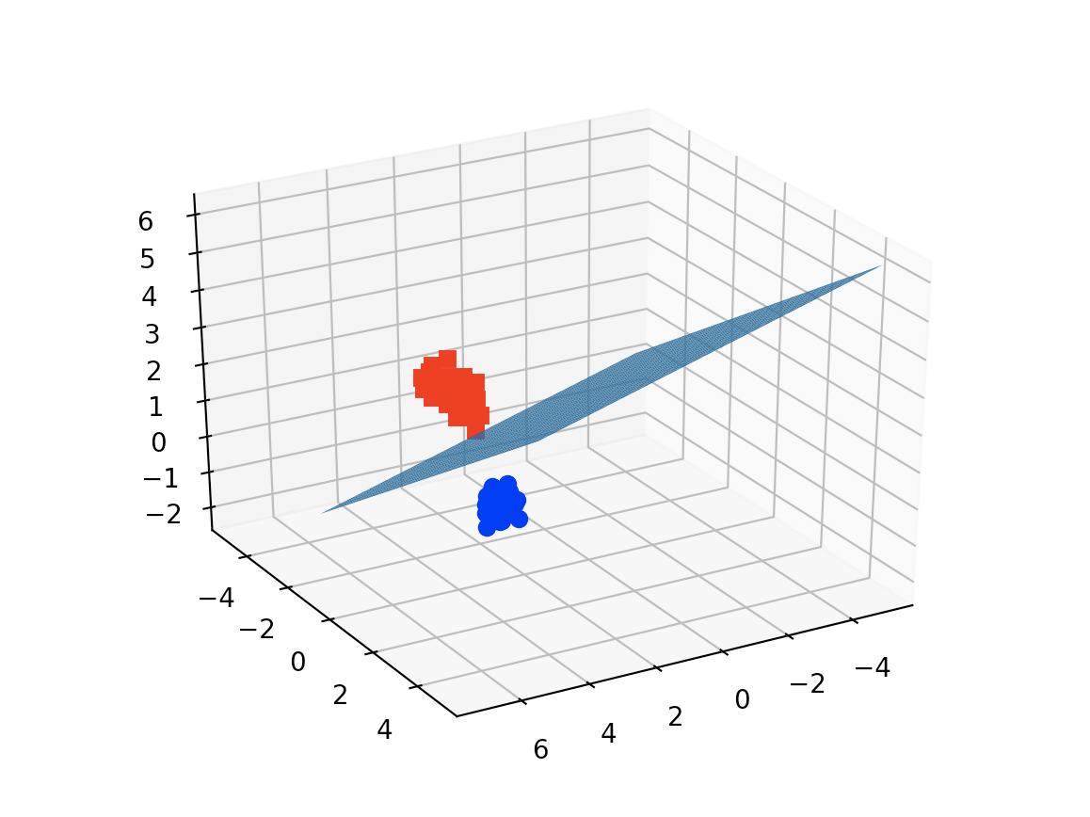
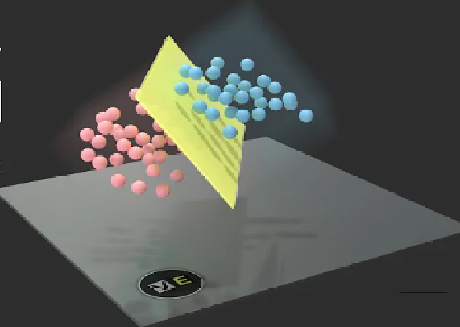
Support Vector Machine (SVM)
Hyperplane for 3D

Slide 12
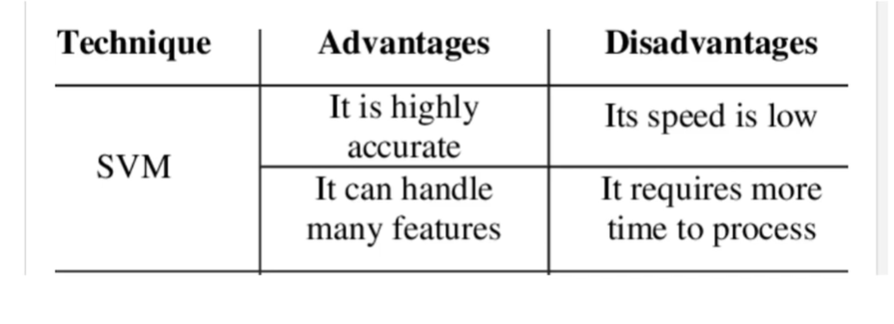
Support Vector Machine (SVM)

Slide 13
Support Vector Machine (SVM)
In Support Vector Machines (SVM), feature scaling or normalization are not strictly required, but are highly recommended, as it can significantly improve model performance and convergence speed.

